Slide 1

PREDICCIÓN DE LA CALIDAD DEL VINO CON MACHINE LEARNING/ Predicting Wine Quality with Machine Learning
María de los Ángeles Rodríguez Escabias
Bootcamp Data Science.

Slide 2
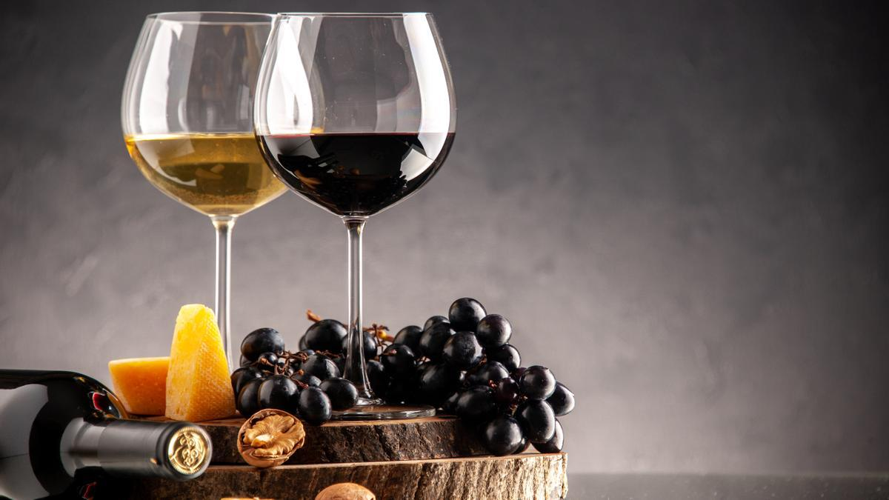
Introducción / introduction

Slide 3
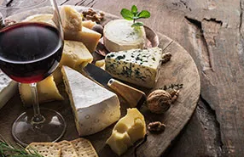
Problema de negocio / Business problem
Wine quality is essential for customer satisfaction and winery reputation.
Traditional quality measurement is costly and slow.
Our model predicts quality based on chemical features, saving time and resources.

Slide 4
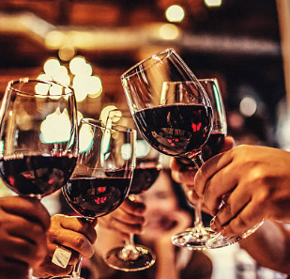
Datos / DATA
“Wine Quality” dataset with physicochemical variables and quality scores.
1599 samples, 12 variables (11 predictors + quality).

Slide 5

Problema Técnico / TECHNICAL PROBLEM
Multiclass classification problem (quality from 3 to 9).
Models evaluated: Random Forest, SVM, XGBoost.

Slide 6

RESULTADOS / RESULTS
Best model: Optimized Random Forest.
Main metric: Macro F1-score ~0.60.
Errors mostly between adjacent classes (e.g., 5 vs 6).

Slide 7

CONCLUSIONES / CONCLUSIONS
Useful model to predict overall quality.
Saves time and costs in quality control.
Can be improved with more data or additional features.

